Slide 1
Sentiment Analysis and Categorization of Mobile Application Reviews

Slide 2
Project Guide : Dr. S.Swamynathan
Team Members :
Reshma Manoj-2013115040
Ishvarya.K – 2013115128
Reshma Sara Pothen – 2013115101

Slide 3
Introduction
Sentiment is an attitude, thought, or judgment prompted by feeling.
Sentiment analysis which is also known as opinion mining, studies people’s sentiments towards certain entities.
Sentiment Analysis can be done on just about any text and it helps reveal the writer’s opinion on the subject matter. It has been used in stock market prediction, movie success prediction, security related data and so on.

Slide 4
Literature Survey
Springer, Journal of Big Data 2015, Sentiment Analysis using product reviews.
The paper details the following:
Data collection and Part of speech tagging.
Sentiment Phrase Identification and score computation
Categorization and result interpretation

Slide 5
Problem Statement
Limitations of existing system:
The first flaw is that since people can freely post their own content, the quality of their opinions cannot be guaranteed. For example, instead of sharing topic-related opinions, online spammers post spam on forums.
The second flaw is that ground truth of such online data is not always available. A ground truth is more like a tag of a certain opinion, indicating whether the opinion is positive, negative, or neutral.
These problems are addressed in our application.

Slide 6
Proposed System
The proposed system can be split into 4 phases.
Phase 1 - Collection, classification and review of data from online
Phase 2 - Sentence extraction and part of speech tagging
Phase 3 - Pruning the data, truth set creation and manual content analysis
Phrase 4 - Result interpretation and evaluation.

Slide 7
Proposed System – contd.,
First, we collect real reviews from app stores and extract their metadata.
Second, we create a truth set by selecting a representative sample of these reviews, manually analysing their content, and labelling their types into 4 – Bug Fixes, User Experience, Feature Request and Rating.
Third, we implement different classifiers using Naïve Bayesian algorithm and use one part of the truth set to train them.
Finally, we evaluate the classifiers’ accuracy and compare the results.

Slide 8
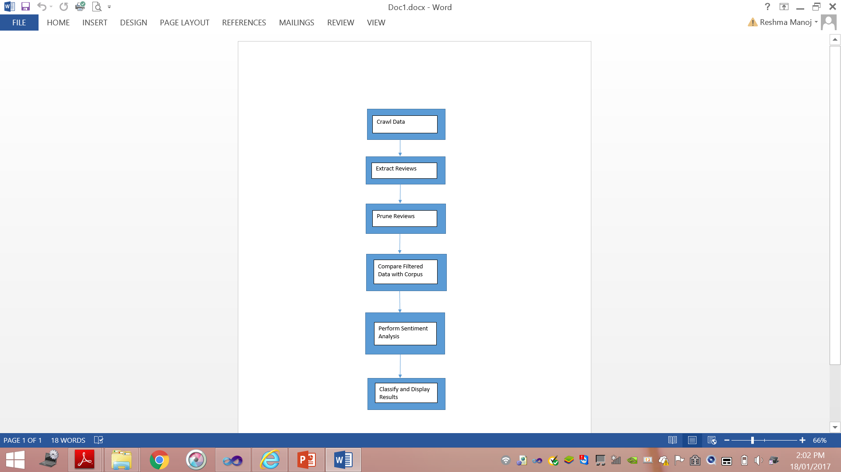
Flow Diagram

Slide 9
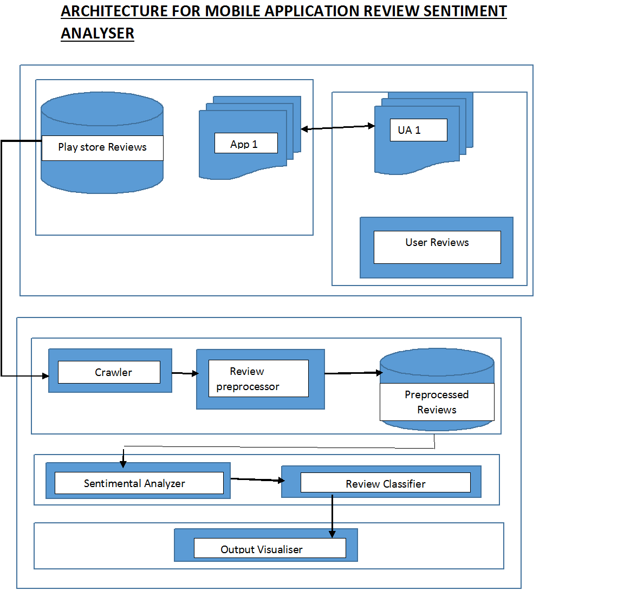

Slide 10
Work Split Up
Crawling, collection and preprocessing of data - 101
Sampling of data and truth set creation – 040,128
Classification using Naïve Bayesian - 101
Evaluation of classification result – 040
Representation of final output - 128

Slide 11
Implementation Tools
Front End :
Software : Visual Studio 2010
Language : C# ASP.net 4.0
Back End Database :
SQL Server 2008

Slide 12
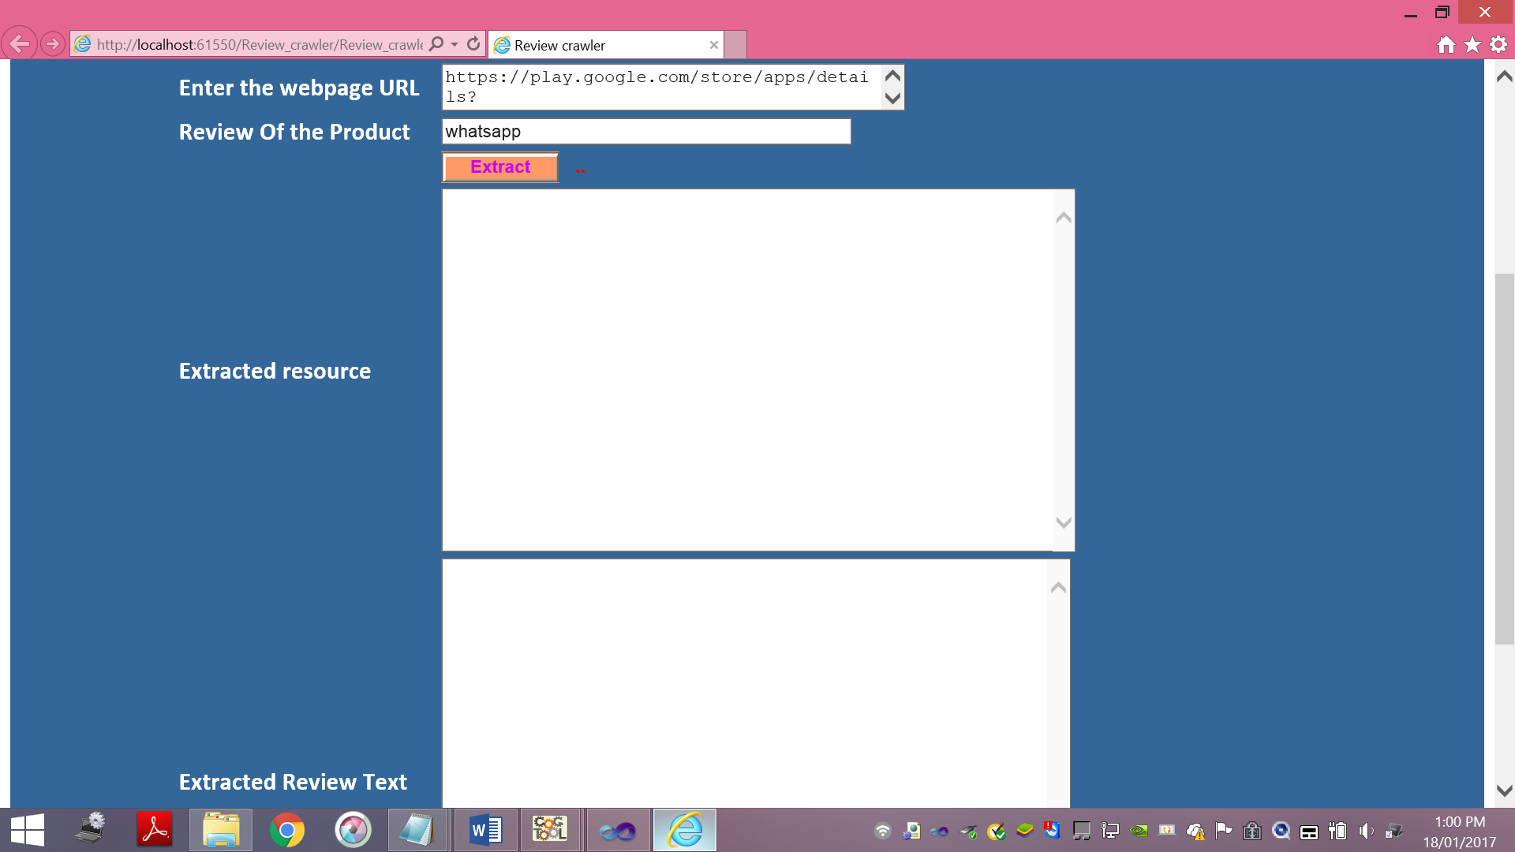
Screenshots

Slide 13
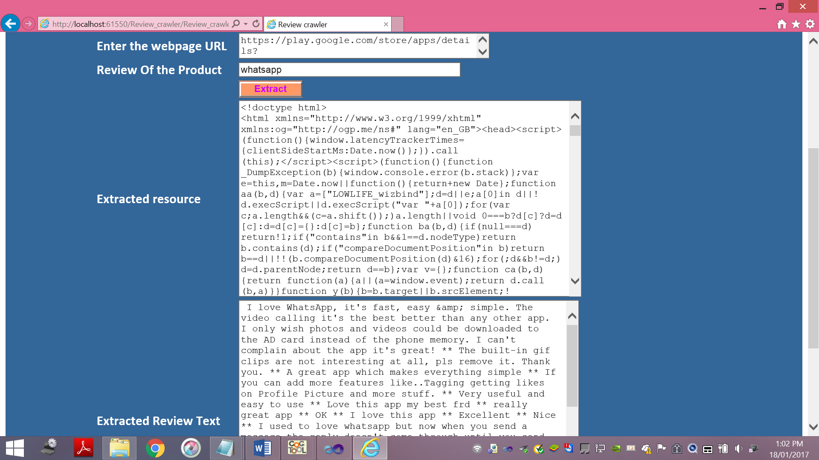

Slide 14
Conclusion
Sentiment analysis or opinion mining is a field of study that analyzes people’s sentiments, attitudes, or emotions towards certain entities. Online mobile app reviews from Playstore and App Store are selected as data used for the study. A sentiment polarity categorization process has been proposed along with detailed descriptions of each step. The system further categorizes them as either Bug Reports, Feature Request, User Experience and Ratings.

Slide 15
References
Kim S-M, Hovy E (2004) Determining the sentiment of opinions. In: Proceedings of the 20th international conference on Computational Linguistics, page 1367. Association for Computational Linguistics, Stroudsburg, PA, USA
Liu B (2010) Sentiment analysis and subjectivity. In: Handbook of Natural Language Processing, Second Edition, Taylor and Francis Group, Boca
Pang B, Lee L (2008) Opinion mining and sentiment analysis.
Google (2016) Google api - https://developers.google.com/product-review-feeds/
N. Bettenburg, S. Just, A. Schröter, C. Weiss, R. Premraj, and T. Zimmermann.
What makes a good bug report? In Proceedings of the 16th ACM SIGSOFT International Symposium on Foundations of software engineering, page 308. ACM Press, Nov. 2008.
Gartner. Number of mobile app downloads worldwide from 2009 to 2017 (in millions). Technical report, Gartner Inc., March 2015.
Amazon (2016) Amazon apis - https://developer.apple.com/app-store/app-analytics/

